Slide 1
CLASSIFICATION BASICS

Slide 2

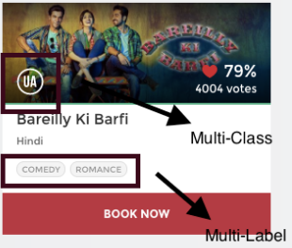

what all things (or labels) are relevant to this picture?

Slide 3
Multiclass & Multilabel
Multiclass classification means a classification task with more than two classes;
e.g.: classify a set of images of fruits which may be oranges, apples, or pears.
Multiclass classification makes the assumption that each sample is assigned to one and only one label:
a fruit can be either an apple or a pear but not both at the same time.
Multilabel classification assigns to each sample a set of target labels.
This can be thought as predicting properties of a data-point that are not mutually exclusive, such as topics that are relevant for a document.
A text might be about any of religion, politics, finance or education at the same time or none of these.

Slide 4
Multiclass vs. Multilabel
In multi-class problems the classes are mutually exclusive, whereas for multi-label problems each label represents a different classification task, but the tasks are somehow related
The multi-label problem requires the model to learn the correlation between the different classes, but in multiclass problems different classes are independent of each other
Multi Class classification Problem One right answer and Mutually exclusive outputs(eg iris, numbers) Multi Label Classification more than one right answer and appropriate output or Non exclusive eg(sugar test, eye test)

